Slide 1
AZ-104T00A Administer Network Traffic

Slide 2



Administer Network Traffic Introduction
Configure Network Routing and Endpoints
Configure Azure Load Balancer
Configure Application Gateway
Configure Network Watcher
Lab 06 – Implement Traffic Management
Notes:
Module overview

Slide 3
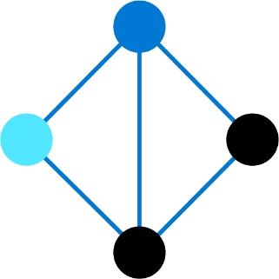
Configure Network Routing and Endpoints

Slide 4
Configure Network Routing and Endpoints Introduction
Review System Routes
Identify User-Defined Routes
Demonstration – Custom Routing tables
Examine a Routing Example
Determine Service Endpoint Uses
Identify Private Link Uses
Summary and Resources
Notes:
Configure and manage virtual networking (25–30%)
Implement and manage virtual networking
* Configure user-defined network routes.
* Configure endpoints on subnets.
* Configure private endpoints.

Slide 5

Review System Routes
System routes direct network traffic between virtual machines, on-premises networks, and the internet:
Traffic between VMs in the same subnet
Between VMs in different subnets in the same virtual network
Data flow from VMs to the internet
Communication between VMs using a VNet-to-VNet VPN
Site-to-Site and ExpressRoute communication through the VPN gateway
Internet
System
Route
System
Route
Frontend Subnet
Backend Subnet
Routing Table
Virtual Network
Notes:
System routes - https://docs.microsoft.com/azure/virtual-network/virtual-networks-udr-overview#system-routes

Slide 6
Identify User-Defined Routes
A route table contains a set of rules, called routes, that specifies how packets should be routed in a virtual network
Internet
User defined route
VM/Appliance
IP Forwarding
User-defined routes are custom routes that control network traffic by defining routes that specify the next hop of the traffic flow
System
Route
Frontend Subnet
Backend Subnet
The next hop can be a virtual network gateway, virtual network, internet, or virtual appliance
User defined route
VM/Appliance
IP Forwarding
Virtual Network
Notes:
Virtual network traffic routing - https://docs.microsoft.com/azure/virtual-network/virtual-networks-udr-overview
✔ Each route table can be associated to multiple subnets, but a subnet can only be associated to a single route table. There are no additional charges for creating route tables in Microsoft Azure. Do you think you will need to create custom routes?

Slide 7
Demonstration – Custom Routing Tables
Create a route table
Add a route
Associate a route table to a subnet
Use PowerShell to view your routing information (optional)
Notes:
✔ Always consider having students walk-through the demonstrations themselves. Also, consider the overlap with the formal labs and your best use of time.

Slide 8
Service Endpoint
Improved security for your Azure service resources. Service endpoints secure Azure service resources to your virtual network by extending VNet identity to the service. When service endpoints are enabled in your virtual network, you secure Azure service resources to your virtual network by adding a virtual network rule. The rule improves security by fully removing public Internet access to resources, and allowing traffic only from your virtual network.
Optimal routing for Azure service traffic from your virtual network. Today, any routes in your virtual network that force Internet traffic to your premises and/or virtual appliances, known as forced-tunneling, also force Azure service traffic to take the same route as the Internet traffic. Service endpoints provide optimal routing for Azure traffic.
Endpoints always take service traffic directly from your virtual network to the service on the Microsoft Azure backbone network. Keeping traffic on the Azure backbone network allows you to continue auditing and monitoring outbound Internet traffic from your virtual networks, through forced-tunneling, without impacting service traffic.

Slide 9
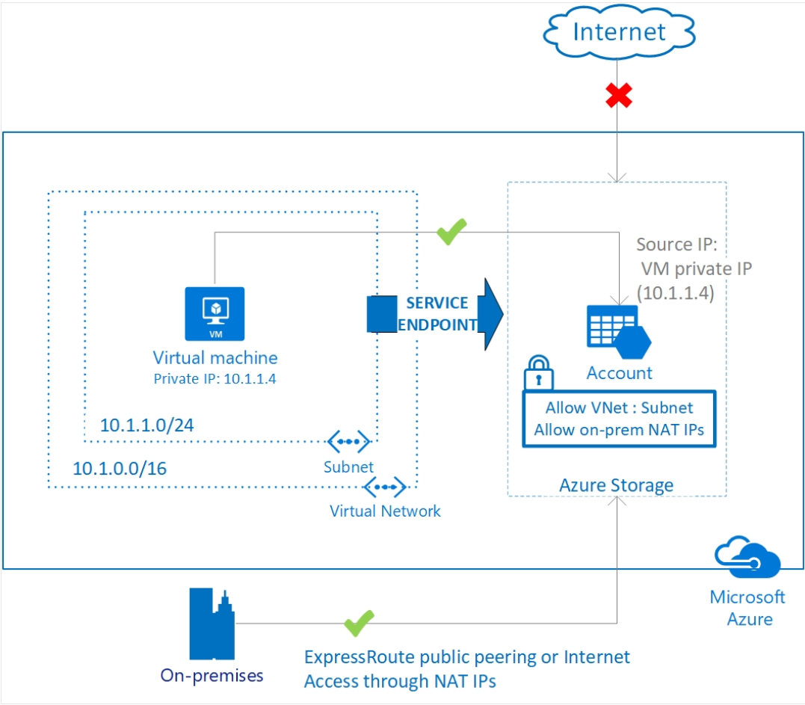
Service Endpoint Architecture

Slide 10
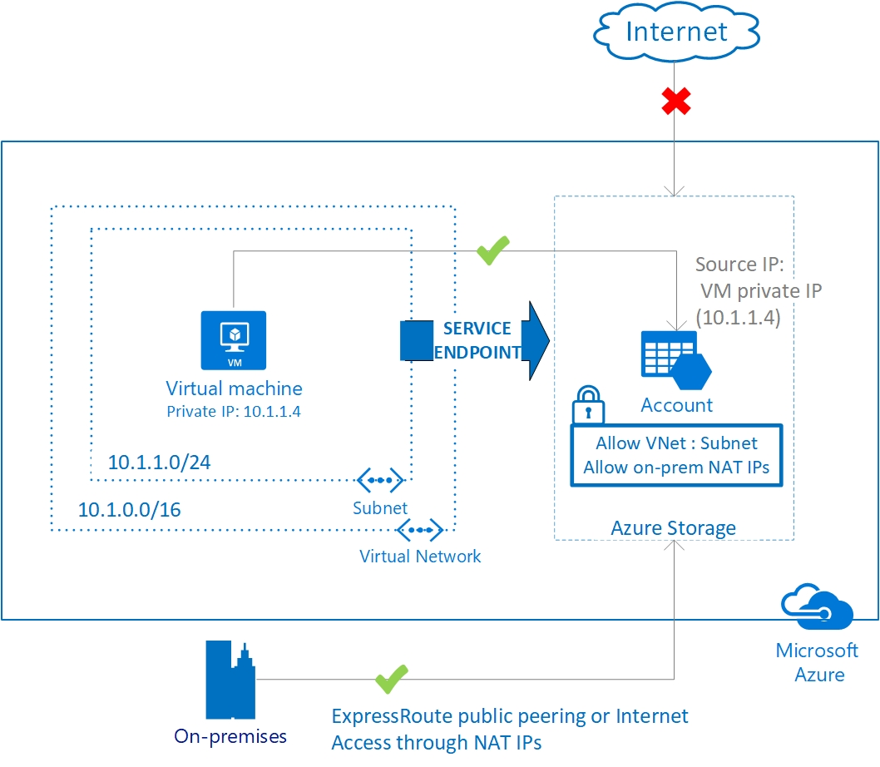
Service Endpoint Uses
Endpoints limit network access to specific services - Adding service endpoints can take up to 15 minutes to complete
Notes:
This is 2 topics in the student content.
Virtual network service endpoints - https://docs.microsoft.com/azure/virtual-network/virtual-network-service-endpoints-overview
Tutorial: Restrict network access to PaaS resources with virtual network service endpoints using the Azure portal - https://docs.microsoft.com/azure/virtual-network/tutorial-restrict-network-access-to-resources
Improved security for your resources
Optimal routing for your services
Uses the Azure backbone and is simple to configure
✔️ Can you see a use for service endpoints in your organization?

Slide 11
What is Private Link and Private Endpoints?
Azure Private Link provides private connectivity from a virtual network to Azure platform as a service (PaaS), customer-owned, or Microsoft partner services. It simplifies the network architecture and secures the connection between endpoints in Azure by eliminating data exposure to the public internet.
Private connectivity to services on Azure. Traffic remains on the Microsoft network, with no public internet access. Connect privately to services running in other Azure regions. Private Link is global and has no regional restrictions.
Integration with on-premises and peered networks. Access private endpoints over private peering or VPN tunnels from on-premises or peered virtual networks. Microsoft hosts the traffic, so you don’t need to set up public peering or use the internet to migrate your workloads to the cloud.
Protection against data exfiltration for Azure resources. Use Private Link to map private endpoints to Azure PaaS resources. When there's a security incident within your network, only the mapped resource would be accessible, eliminating the threat of data exfiltration.
Services delivered directly to your customers’ virtual networks. Privately consume Azure PaaS, Microsoft partner, and your own services in your virtual networks on Azure. Private Link works across Azure Active Directory (Azure AD) tenants to help unify your experience across services. Send, approve, or reject requests directly, without permissions or role-based access controls.
Notes:
Stress the difference between Private Link and Private Endpoint

Slide 12
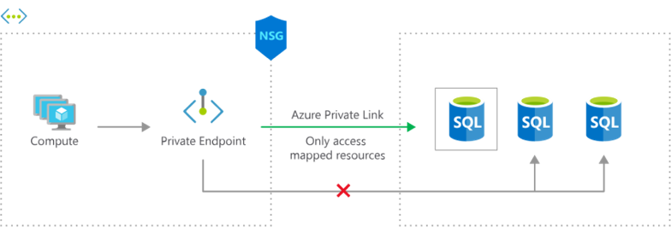
Identify Private Link Uses
Private connectivity to services on Azure. Traffic remains on the Microsoft network, with no public internet access
Integration with on-premises and peered networks
In the event of a security incident within your network, only the mapped resource would be accessible
Notes:
Private Link Documentation - https://docs.microsoft.com/azure/private-link/

Slide 13
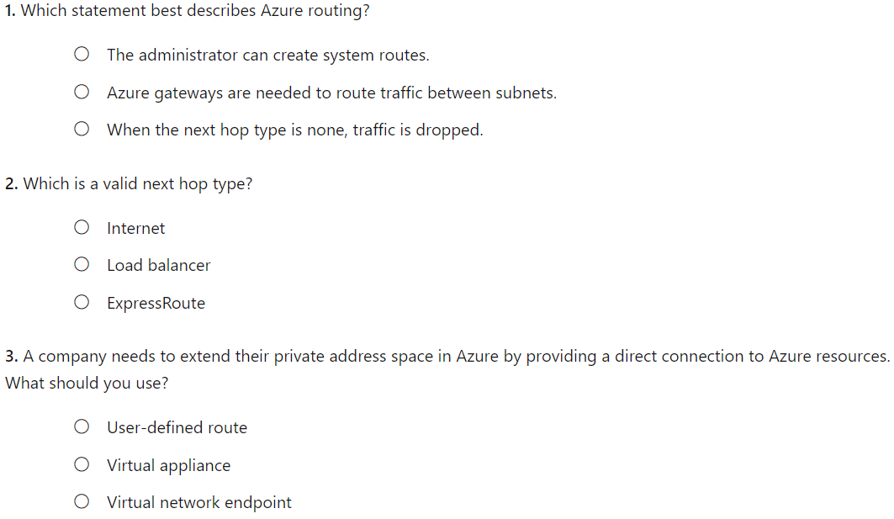
Knowledge Check

Slide 14
Summary and Resources – Configure Network Routing and Endpoints
Knowledge Check Questions
Microsoft Learn Modules (docs.microsoft.com/Learn)
Manage and control traffic flow in your Azure deployment with routes (Sandbox)
Introduction to Azure Private Link
A sandbox indicates a hands-on exercise.
Notes:
Learn - https://docs.microsoft.com/learn/browse
The Assessment Guide in the MCT DLC has open-ended questions.
What is the difference between system-defined routes and user-defined routes? Give an example where each type of route would be used.
Answer: System-defined routes direct network traffic between virtual machines, on-premises networks, and the internet. System-defined routes are the default behavior for Azure routing. Examples include traffic between VMs in the same subnet, between VMs in different subnets in the same virtual network, and data flow from VMs to the internet. User-defined (custom) routes override the system routes or add routes to the routing table. Examples include routing through gateways and virtual appliances.
What is the difference between a service endpoint and a private endpoint?
Answer: A service endpoint limits network access to specific subnets and IP addresses. A service endpoint is a web address (URL) at which clients of a specific service can gain access to it. Service endpoints are supported for a variety of services including Storage, Key Vault, and SQL. A private endpoint. A private endpoint is a network interface that uses a private IP address from your virtual network. This network interface connects you privately and securely to a service through a private link. Private link integrates with on-premises and peered networks.

Slide 15
Configure Azure Load Balancer

Slide 16
Configure Azure Load Balancer Introduction
Choose a Load Balancer Solution
Implement a Public Load Balancer
Implement an Internal Load Balancer
Determine Load Balancer SKUs
Create Backend Pools
Create Load Balancer Rules
Configure Session Persistence (optional)
Summary and Resources
Notes:
Configure and manage virtual networking (25–30%)
Configure load balancing
* Configure an internal or public load balancer.
* Troubleshoot load-balancing.

Slide 17
Choose a Load Balancer Solution
Feature | Application Gateway | Front Door | Load Balancer | Traffic Manager
Usage | Optimize delivery from application server farms while increasing application security with web application firewall. | Scalable, security-enhanced delivery point for global, micro service-based web applications. | Balance inbound and outbound connections and requests to your applications or server endpoints. | Distribute traffic optimally to services across global Azure regions, while providing high availability and responsiveness.
Protocols | HTTP, HTTPS, HTTP2 | HTTP, HTTPS, HTTP2 | TCP, UDP | Any
Private | Yes |  | Yes
Global |  | Yes |  | Yes
Env | Azure, non-Azure cloud, on premises | Azure, non-Azure cloud, on premises | Azure | Azure, non-Azure cloud, on premises
Security | WAF | WAF, NSG | NSG
Notes:
This slide is not in the student materials. It is designed to help students understand that the Azure Load Balancer is not the only product solution. Use the portal and the “Load Balancing – help me choose” page to review the options.
Load-balancing options - Azure Architecture Center | Microsoft Docs - https://docs.microsoft.com/azure/architecture/guide/technology-choices/load-balancing-overview
Does your application use HTTP/HTTPS?
Is your application public (internet facing)?
Is your application deployed in multiple regions?

Slide 18
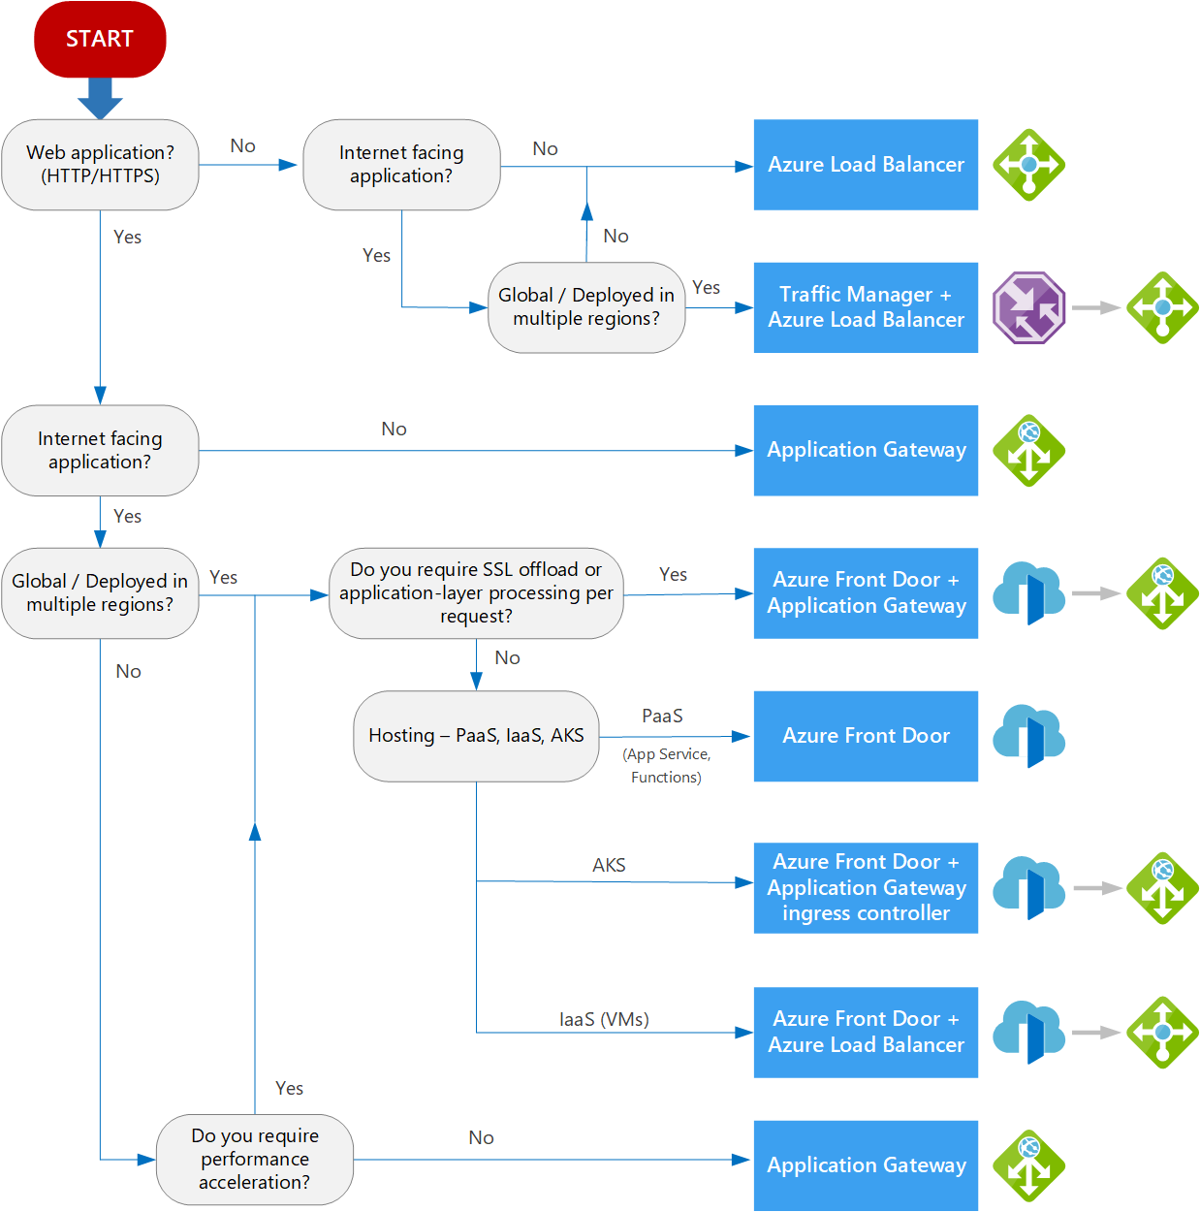
Notes:
Compare LB offerings
App GW / LB are private instances which are not global
FD / TM these are global resources

Slide 19
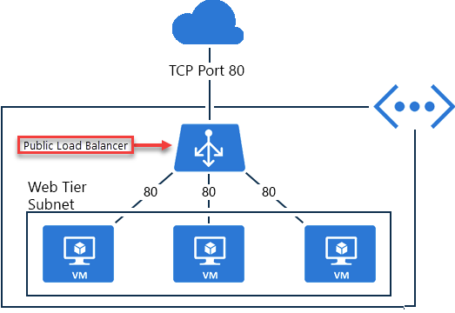
Implement a Public Load Balancer
Maps public IP addresses and port number of incoming traffic to the VM’s private IP address and port number, and vice versa
Apply load balancing rules to distribute traffic across VMs or services
Notes:
The Azure Load Balancer delivers high availability and network performance to your applications. The load balancer distributes inbound traffic to backend resources using load-balancing rules and health probes.
Load-balancing rules determine how traffic is distributed to the backend.
Health probes ensure the resources in the backend are healthy.
The Load Balancer can be used for inbound and outbound scenarios and scales up to millions of TCP and UDP application flows.
Four pieces of configuration needed with LB - Frontend IP configuration, Backend pools, Health probes, and Load-balancing rules.

Slide 20
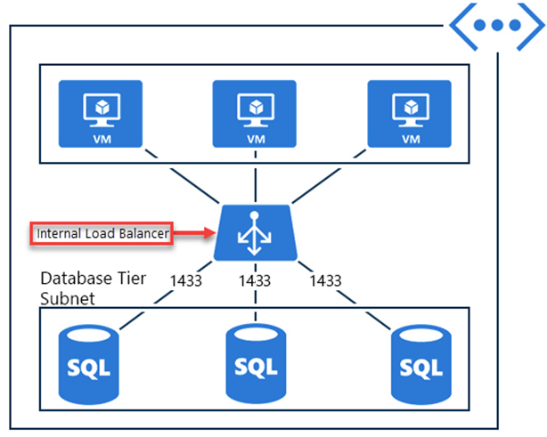
Implement an Internal Load Balancer
Directs traffic only to resources inside a virtual network or that use a VPN to access Azure infrastructure
Frontend IP addresses and virtual networks are never directly exposed to an internet endpoint
Enables load balancing within a virtual network, for cross-premises virtual networks, for multi-tier applications, and for line-of-business applications
Notes:
✔ Can you see how a public load balancer could be placed in front of the internal load balancer to create a multi-tier application.
There are two types of load balancers: public and internal.
A public load balancer maps the public IP address and port number of incoming traffic to the private IP address and port number of the VM. Mapping is also provided for the response traffic from the VM. By applying load-balancing rules, you can distribute specific types of traffic across multiple VMs or services. For example, you can spread the load of incoming web request traffic across multiple web servers.
The diagram shows internet clients sending webpage requests to the public IP address of a web app on TCP port 80. Azure Load Balancer distributes the requests across the three VMs in the load-balanced set.

Slide 21
Internal Load Balancing
Within a virtual network. Load balancing from VMs in the virtual network to a set of VMs that reside within the same virtual network.
For a cross-premises virtual network. Load balancing from on-premises computers to a set of VMs that reside within the same virtual network.
For multi-tier applications. Load balancing for internet-facing multi-tier applications where the backend tiers are not internet-facing. The backend tiers require traffic load-balancing from the internet-facing tier.
For line-of-business applications. Load balancing for line-of-business applications that are hosted in Azure without additional load balancer hardware or software. This scenario includes on-premises servers that are in the set of computers whose traffic is load-balanced.

Slide 22
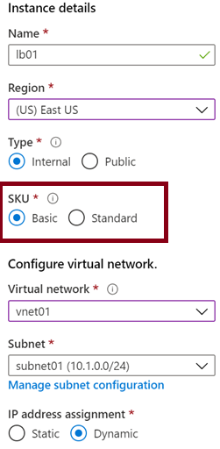
Determine Load Balancer SKUs
Feature | Basic SKU | Standard SKU
Backend pool | Up to 300 instances | Up to 1000 instances
Health probes | TCP, HTTP | TCP, HTTP, HTTPS
Availability zones | Not available | Zone-redundant and zonal frontends for inbound and outbound traffic
Multiple frontends | Inbound only | Inbound and outbound
Secure by default | Open by default. NSG optional. | Closed to inbound flows unless allowed by a NSG. Internal traffic from the virtual network to the internal load balancer is allowed.
SLA | Not available | 99.99%
Notes:
Load balancer SKUs - https://docs.microsoft.com/azure/load-balancer/skus

Slide 23
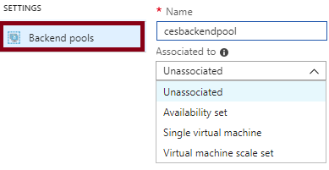
Create Backend Pools
SKU | Backend pool endpoints
Basic SKU | VMs in a single availability set or VM scale set
Standard SKU | Any VM in a single virtual network, including a blend of VMs, availability sets, and VM scale sets
To distribute traffic, a back-end address pool contains the IP addresses of the virtual NICs that are connected to the load balancer
Notes:
✔ In the Standard SKU you can have up to 1000 instances in the backend pool. In the Basic SKU you can have up to 100 instances.

Slide 24
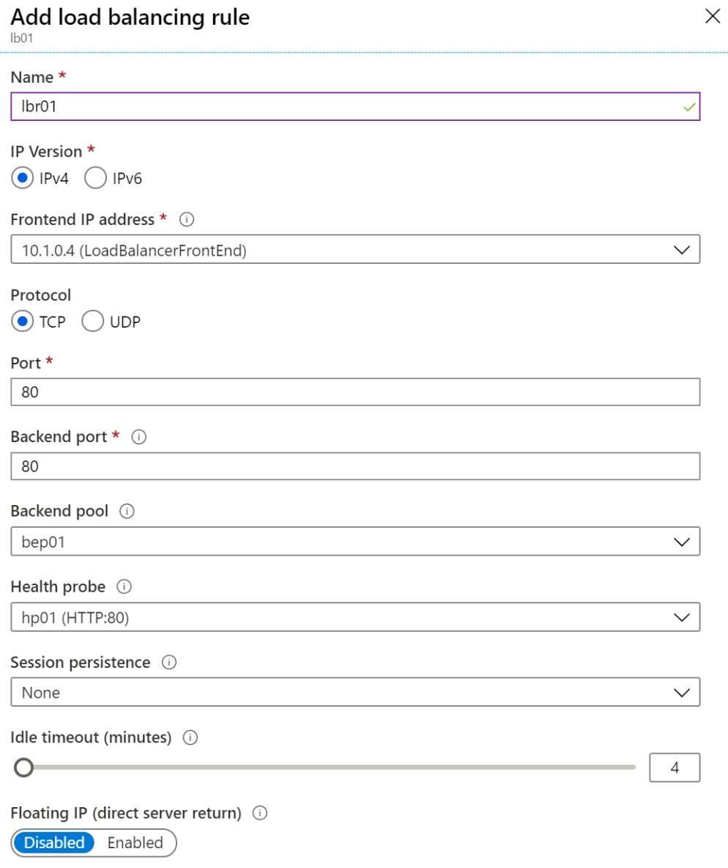
Create Load Balancer Rules
Maps a frontend IP and port combination to a set of backend pool and port combination
Rules can be combined with NAT rules
A NAT rule is explicitly attached to a VM (or network interface) to complete the path to the target
Notes:
Tutorial: Load balance internet traffic to VMs using the Azure portal - https://docs.microsoft.com/azure/load-balancer/tutorial-load-balancer-standard-manage-portal
✔ Can you see the difference between load balancing rules and NAT rules? Remember, this approach should only be used when you need connectivity from the Internet. Most normal communications would occur from on-premises to Azure connections such as site-to-site VPN and ExpressRoute.

Slide 25
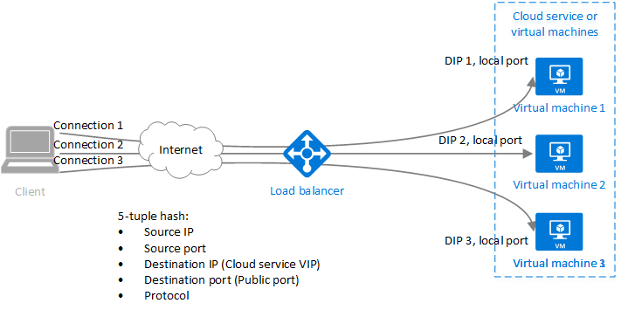
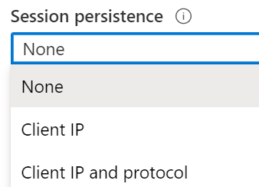
Configure Session Persistence (optional)
Session persistence specifies how client traffic is handled
None (default) requests can be handled by any virtual machine
Client IP requests will be handled by the same virtual machine
Client IP and protocol specifies that successive requests from the same address and protocol will be handled by the same virtual machine
Notes:
The student materials have a Health Probes topic. The slide is at the end if you need it.
✔ Keeping session persistence information is very important in applications that use a shopping cart. Can you think of any other applications?
None (default) specifies any virtual machine can handle the request.
Client IP specifies that successive requests from the same client IP address will be handled by the same virtual machine.
Client IP and protocol specifies that successive requests from the same client IP address and protocol combination will be handled by the same virtual machine.

Slide 26
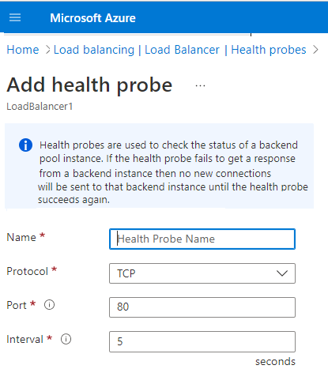
Health Probes
Azure Load Balancer will not send traffic to a backend instance if a health probe is not configured and working.
Two types of probe exist HTTP or TCP.
HTTP custom probe. The load balancer regularly probes your endpoint (every 15 seconds, by default). The instance is healthy if it responds with an HTTP 200 within the timeout period (default of 31 seconds). Any status other than HTTP 200 causes the probe to fail.
TCP custom probe. This probe relies on establishing a successful TCP session to a defined probe port. If the specified listener on the VM exists, the probe succeeds. If the connection is refused, the probe fails. You can specify the Port, Interval, and Unhealthy threshold.

Slide 27
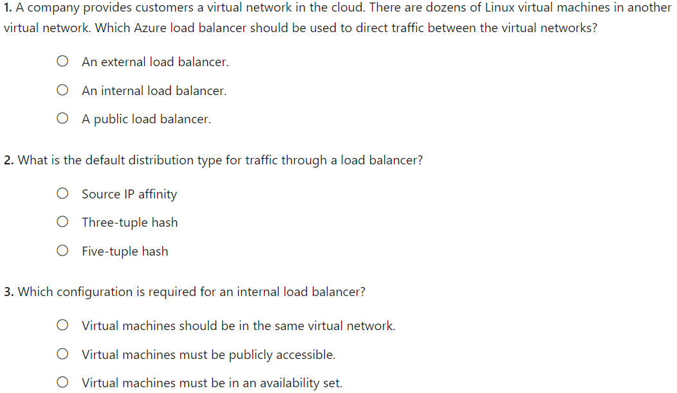
Knowledge Check
Notes:
B
C
A

Slide 28
Summary and Resources – Configure Azure Load Balancer
Knowledge Check Questions
Microsoft Learn Modules (docs.microsoft.com/Learn)
Improve application scalability and resiliency by using Azure Load Balancer (Sandbox)
Load balance non-HTTP(S) traffic in Azure
A sandbox indicates a hands-on exercise.
Notes:
Learn - https://docs.microsoft.com/learn/browse
The Assessment Guide in the MCT DLC has open-ended questions.
What is a load balancer and what two types of load balancer does Azure provide? Give an example of where each type of load balancer would be used.
Answer: A load balancer distributes inbound and outbound traffic using load-balancing rules and health probes. There are two types of load balancers: public and internal. Public facing load balancers maps external IP addresses to internal IP addresses, and vice versa. Public load balancers handle external requests to backend resources, like SQL servers. Internal load balancers direct traffic only to resources inside a virtual network or that use a VPN. Internal load balancers can be used for cross-premises virtual networks, for multi-tier applications, and for line-of-business application balancing.
List at least three types of Azure load balancers. For each load balance describe the usage scenarios.
Answer: The Application Gateway can optimize delivery from application server farms while increasing application security with web application firewall. Front Door is a scalable, security-enhanced delivery point for global, micro service-based web applications. The Azure Load Balancer balances inbound and outbound connections and requests to your applications or server endpoints. Traffic Manager distributes traffic optimally to services across global Azure regions, while providing high availability and responsiveness.

Slide 29
Configure Azure Application Gateway
Notes:
Configure and manage virtual networking (25–30%)
Configure load balancing
* Configure Azure Application gateway.

Slide 30
Configure Azure Application Gateway Introduction
Implement Application Gateway
Determine Application Gateway Routing
Setup Application Gateway Components (optional)
Summary and Resources
Notes:
Configure and manage virtual networking (30-35%)
Configure load balancing
• Configure Application Gateway

Slide 31
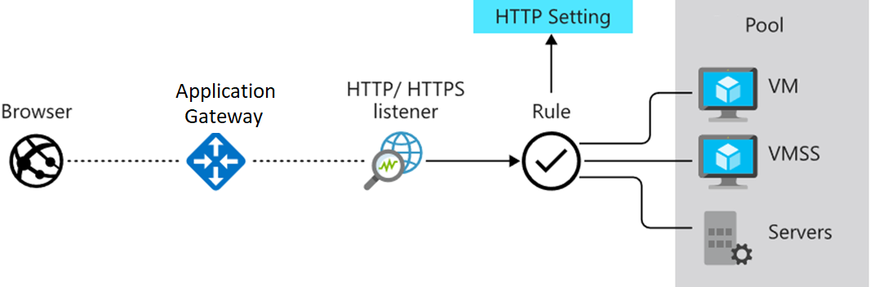
Implement Application Gateway
Manages web app requests
Routes traffic to a pool of web servers based on the URL of a request
The web servers can be Azure virtual machines, Azure virtual machine scale sets, Azure App Service, and even on-premises servers
Notes:
Application Gateway configuration overview - https://docs.microsoft.com/azure/application-gateway/configuration-overview

Slide 32
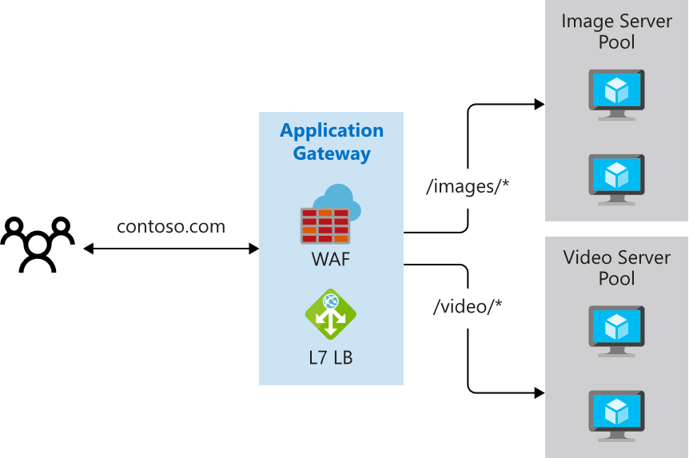
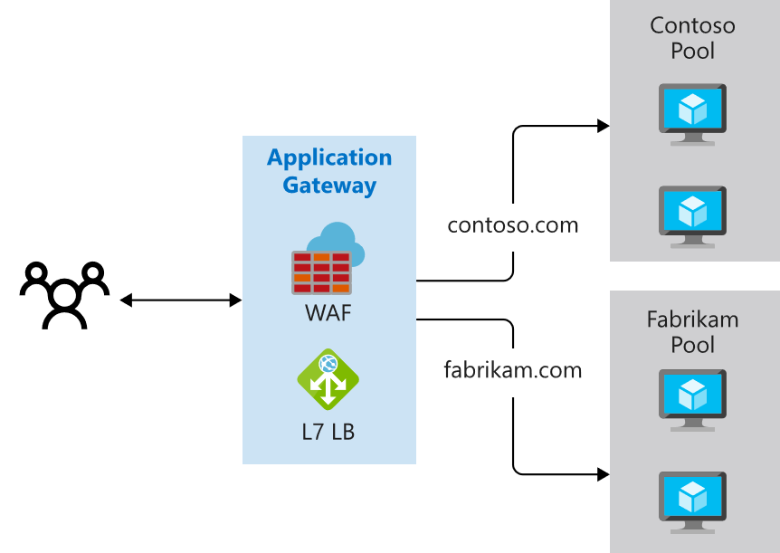
Determine Application Gateway Routing
Path-based routing
Multiple-site routing
Notes:
QuickStart: Direct web traffic with Azure Application Gateway - Azure portal - https://docs.microsoft.com/azure/application-gateway/quick-create-portal

Slide 33
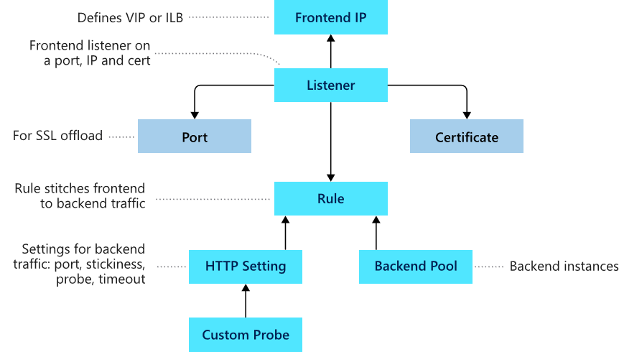
Setup Application Gateway Components (optional)
Frontend IP
Listeners
Routing rules
Backend pools
Web application firewall (optional)
Health probes
Notes:
Load balance your web service traffic with Application Gateway - https://docs.microsoft.com/learn/modules/load-balance-web-traffic-with-application-gateway/

Slide 34
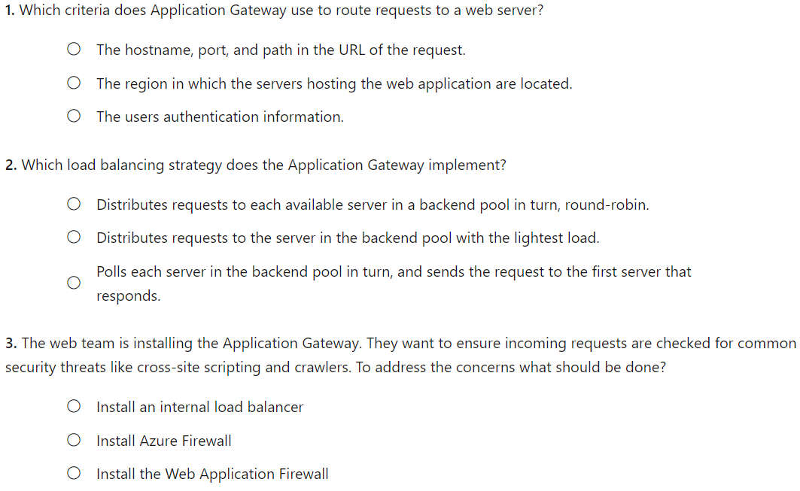
Knowledge Check

Slide 35
Summary and Resources – Configure Azure Application Gateway
Knowledge Check Questions
Microsoft Learn Modules (docs.microsoft.com/Learn)
Introduction to Azure Application Gateway
Load balance your web service traffic with Application Gateway
Load balance HTTP(S) traffic in Azure
Encrypt network traffic end to end with Azure Application Gateway
Notes:
Learn - https://docs.microsoft.com/learn/browse
The Assessment Guide in the MCT DLC has open-ended questions.
Your website uses static image and video. The images and video are located on different backend servers. What solution would you put in place to handle the requests?
Answer: An Application Gateway manages web app requests. The Application Gateway can route traffic to a pool of web servers based on the URL of a request. In this case path-based routing can send URL images to one server and URL videos to another server. Multiple-site routing is also available. For example, one set of servers for one organization and another set of servers for a different organization.

Slide 36
Configure Network Watcher

Slide 37
Configure Network Watcher Introduction
Describe Network Watcher Features
Review IP Flow Verify Diagnostics
Review Next Hop Diagnostics
Visualize the Network Topology
Summary and Resources
Notes:
Instructor – Additional optional slides at the end of the presentation.
Configure and manage virtual networking (30-35%)
Monitor and troubleshoot virtual networking
Monitor on-premises connectivity
Use Network Performance Monitor
Use Network Watcher
Troubleshoot external networking
Troubleshoot virtual network connectivity

Slide 38
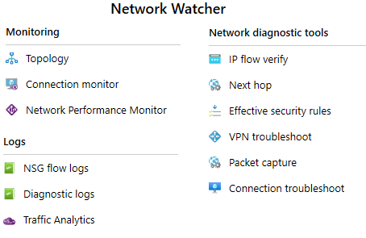
Describe Network Watcher Features
A regional service that provides various network diagnostic and monitoring tools​
IP Flow Verify diagnoses connectivity issues
Next Hop determines if traffic is being correctly routed
VPN Diagnostics troubleshoots gateways and connections
NSG Flow Logs maps IP traffic through a network security group
Connection troubleshoot shows connectivity between source VM and destination
Topology generates a visual diagram of resources

Slide 39
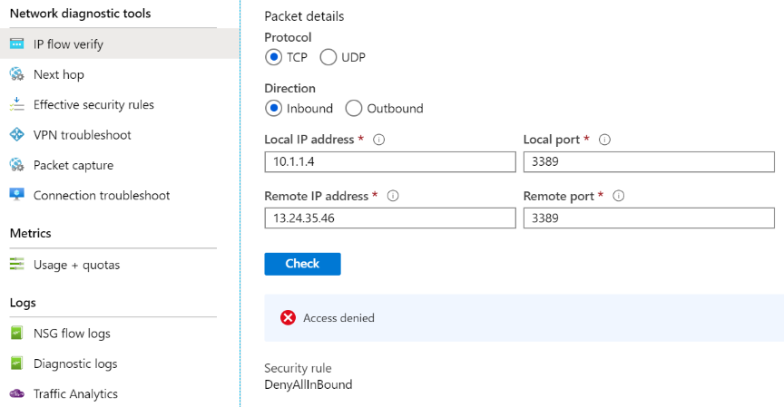
Review IP Flow Verify Diagnostics
Checks if a packet is allowed or denied to or from a virtual machine
Notes:
Introduction to IP flow verify in Azure Network Watcher - https://docs.microsoft.com/azure/network-watcher/network-watcher-ip-flow-verify-overview

Slide 40
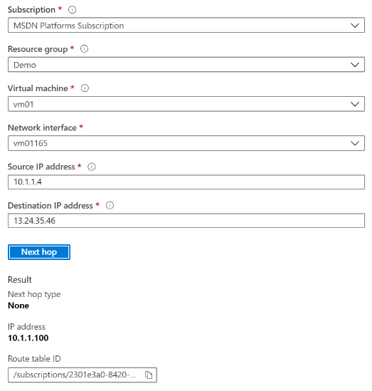
Review Next Hop Diagnostics
Helps with determining whether traffic is being directed to the intended destination by showing the next hop
Notes:
Use next hop to diagnose virtual machine routing problems - https://docs.microsoft.com/azure/network-watcher/network-watcher-next-hop-overview

Slide 41
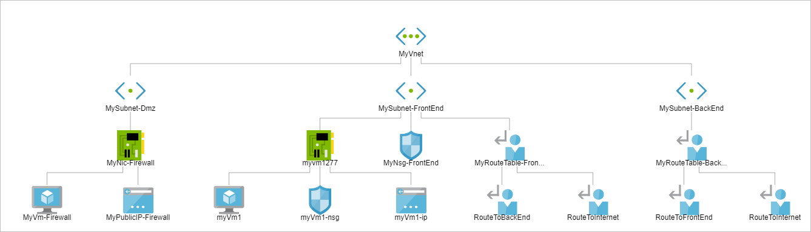
Visualize the Network Topology
Provides a visual representation of your networking elements
View all the resources in a virtual network, resource to resource associations, and relationships between the resources
The Network Watcher instance in the same region as the virtual network
Notes:
View the topology of an Azure virtual network - https://docs.microsoft.com/azure/network-watcher/view-network-topology

Slide 42
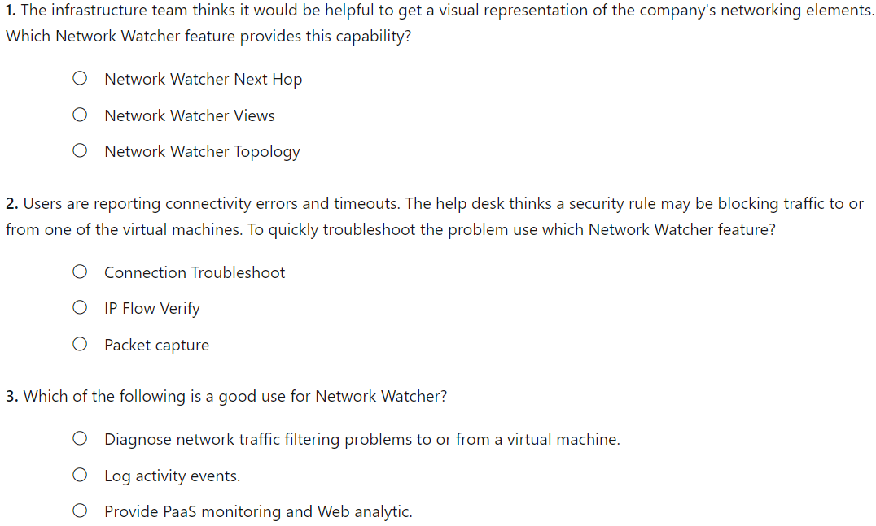
Knowledge Check

Slide 43
Summary and Resources – Configure Network Watcher
Knowledge Check Questions
Microsoft Learn Modules (docs.microsoft.com/Learn)
Introduction to Azure Network Watcher
Monitor and troubleshoot your end-to-end Azure network infrastructure by using network monitoring tools
Analyze your Azure infrastructure by using Azure Monitor logs (Sandbox)
Monitor the performance of virtual machines using Azure Monitor VM Insights (Sandbox)
Write your first query with Kusto Query Language
A sandbox indicates a hands-on exercise.
Notes:
https://docs.microsoft.com/learn/
The Assessment Guide in the MCT DLC has open-ended questions.
Name at least three ways to use Network Watcher to troubleshoot and diagnose network problems.
Answer: Network Watcher is a regional service that provides various network diagnostic and monitoring tools​. IP Flow Verify diagnoses connectivity issues. Next Hop determines if traffic is being correctly routed. VPN Diagnostics troubleshoots gateways and connections. NSG Flow Logs maps IP traffic through a network security group. Connection Troubleshoot shows connectivity between source VM and destination. Topology generates a visual diagram of resources that might be helpful.

Slide 44
Lab – Implement Traffic Management

Slide 45
Lab 06 – Implement traffic management
Scenario
You are tasked with implementing a hub spoke topology for network traffic. The topology should include an Azure Load Balancer and Azure Application Gateway.
Objectives
Task 1: Provision the lab environment
Task 2: Configure the hub and spoke network topology
Task 3: Test transitivity of virtual network peering
Task 4: Configure routing in the hub and spoke topology
Task 5: Implement Azure Load Balancer
Task 6: Implement Azure Application Gateway
Next slide for an architecture diagram
Notes:
LAB 06 - Implement Traffic Management - ESTIMATED DURATION 60 MIN
Lab Repository - https://microsoftlearning.github.io/AZ-104-MicrosoftAzureAdministrator/

Slide 46






Lab 06 – Architecture Diagram
Task6
Task1
az104-06-rg5
az104-06-rg1
az104-06-vnet01 10.60.0.0/22
Subnet0 10.60.0.0/24
Subnet1 10.60.1.0/24
Subnet-appgw 10.60.3.224/27
az104-06-appgw5
az104-06-vm0
10.60.0.4
az104-06-vm1
10.60.1.4
az104-06-pip5
Task2, Task3
Peering
Peering
Task4
Task5
Subnet0 10.63.0.0/24
Task4
Subnet0 10.62.0.0/24
az104-06-rt23
az104-06-vm2
10.62.0.4
az104-06-lb4
az104-06-vm3
10.63.0.4
az104-06-rt32
az104-06-vnet2 10.62.0.0/22
az104-06-pip4
az104-06-vnet3 10.63.0.0/22
az104-06-rg4
az104-06-rg1
az104-06-rg1
Notes:
Break down the explanation by reviewing the components in each of the three virtual networks.

Slide 47

End of presentation

Slide 48
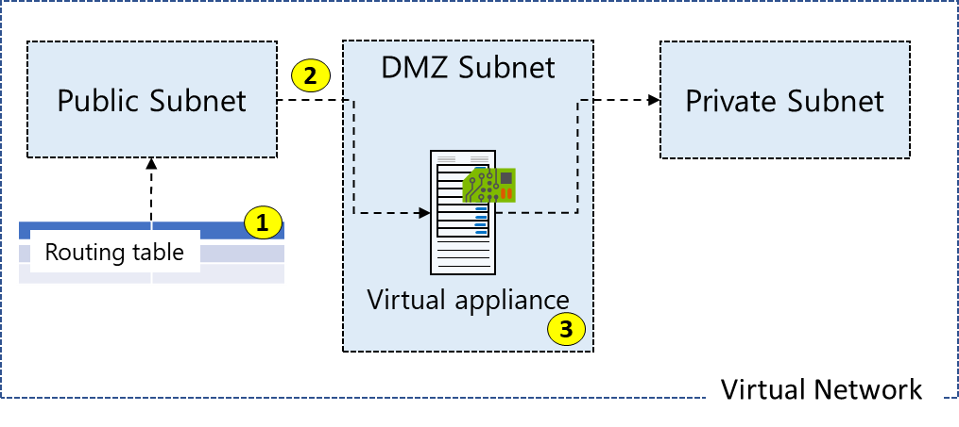
Routing Example (optional)
All traffic coming into the public subnet and headed for the private subnet must be go through the virtual network appliance
Create a routing table
Add a custom route that requires all private subnet traffic be directed to a network appliance
Associate the new route to the public subnet
Notes:
Manage and control traffic flow in your Azure deployment with routes - https://docs.microsoft.com/learn/modules/control-network-traffic-flow-with-routes/
The next three topics will cover this information.

Slide 49
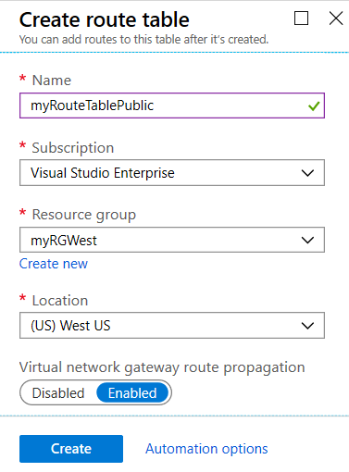
Create a Routing Table (optional)
A standard routing protocol is used to exchange routing and reachability information between two or more networks
Routes are automatically added to the route table of all subnets with virtual network gateway route propagation enabled
In most situations you will want to enable route propagation
Notes:
Overview of BGP with Azure VPN Gateways - https://docs.microsoft.com/azure/vpn-gateway/vpn-gateway-bgp-overview?toc=%2fazure%2fvirtual-network%2ftoc.json

Slide 50
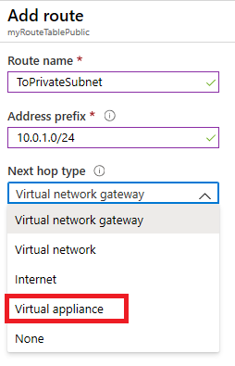
Create a Custom Route (optional)
When you create a route there are several Next hop types
In this example, any private subnet IP addresses will be sent to the virtual appliance
Other choices are Virtual network gateway, Virtual network, Internet, and None

Slide 51
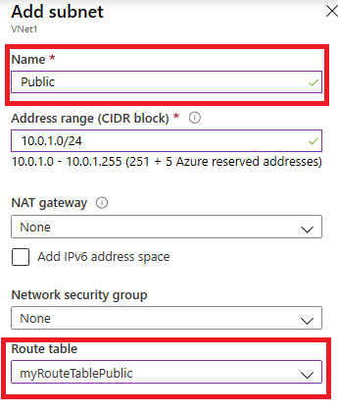
Associate the Route Table (optional)
Each subnet can have zero or one route table associated to it
In our example, the Public subnet will be associated with the routing table
Notes:
✔️ In this case the virtual appliance should not have a public IP address and IP forwarding should be enabled.

Slide 52
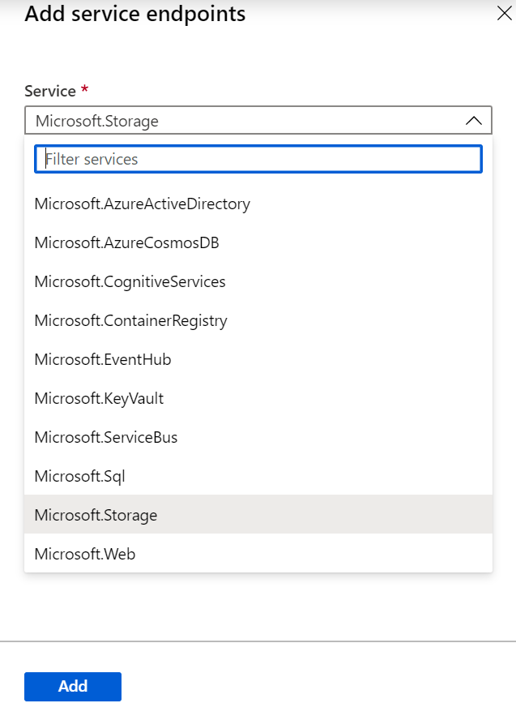
Determine Service Endpoint Services
There are many types of service endpoints
Adding service endpoints can take up to 15 minutes to complete

Slide 53
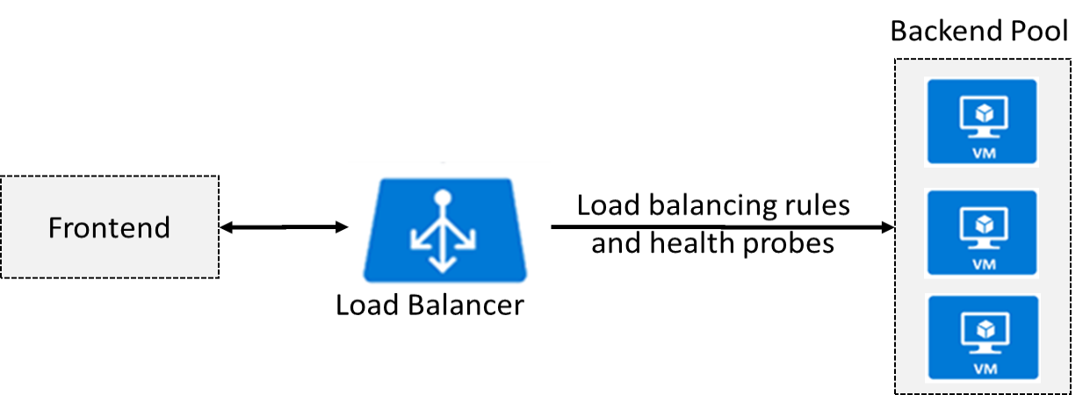
Determine Azure Load Balancer Uses
Distributes inbound traffic to backend resources using load-balancing rules and health probes
Can be used for both inbound/outbound scenarios
Two types: Public and Internal
Notes:
What is Azure Load Balancer? - https://docs.microsoft.com/azure/load-balancer/load-balancer-overview
Azure Load Balancer Components - https://docs.microsoft.com/azure/load-balancer/components
✔ Keep this diagram in mind since it covers the four components that must be configured for your load balancer: Frontend IP configuration, Backend pools, Health probes, and Load balancing rules.

Slide 54
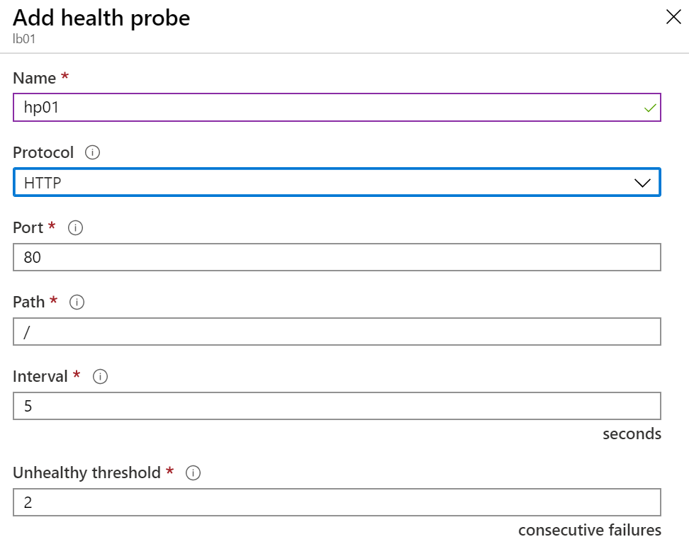
Create Health Probes (optional)
Allows the load balancer to monitor the status of an app
Dynamically adds or removes VMs from the load balancer rotation based on their response to health checks
HTTP custom probe (preferred) pings every 15 seconds
TCP custom probe tries to establish a successful TCP session
Notes:
Load Balancer health probes - https://docs.microsoft.com/azure/load-balancer/load-balancer-custom-probe-overview
✔ There is also a guest agent probe. This probe uses the guest agent inside the VM. It is not recommended when HTTP or TCP custom probe configurations are possible. Relate back to the original diagram to ensure all the components are covered.

